Slide 1

Girl Develop It!
INTRO TO UX RESEARCH

Slide 2
Welcome!
Girl Develop It Virtual Course

Slide 3
AGENDA
10 MIN | Introductions
20 MIN | What is user research?
20 MIN | Why is user research important?
5 MIN | Bio Break
15 MIN | How do you do user research?
35 MIN | Walkthrough Activity: Planning and executing user research interviews
10 MIN | Debrief
5 MIN | Q&A & Wrap-Up

Slide 4

MEET YOUR INSTRUCTOR
Nechari Riley
Girl Develop It Member Since ‘15
Principal Designer &
Design Justice Advocate
Collard Green Lover

Slide 5
INTRODUCTIONS
Introduce Yourselves!
Name
Pronouns
Location
What are you interested in learning?

Slide 6
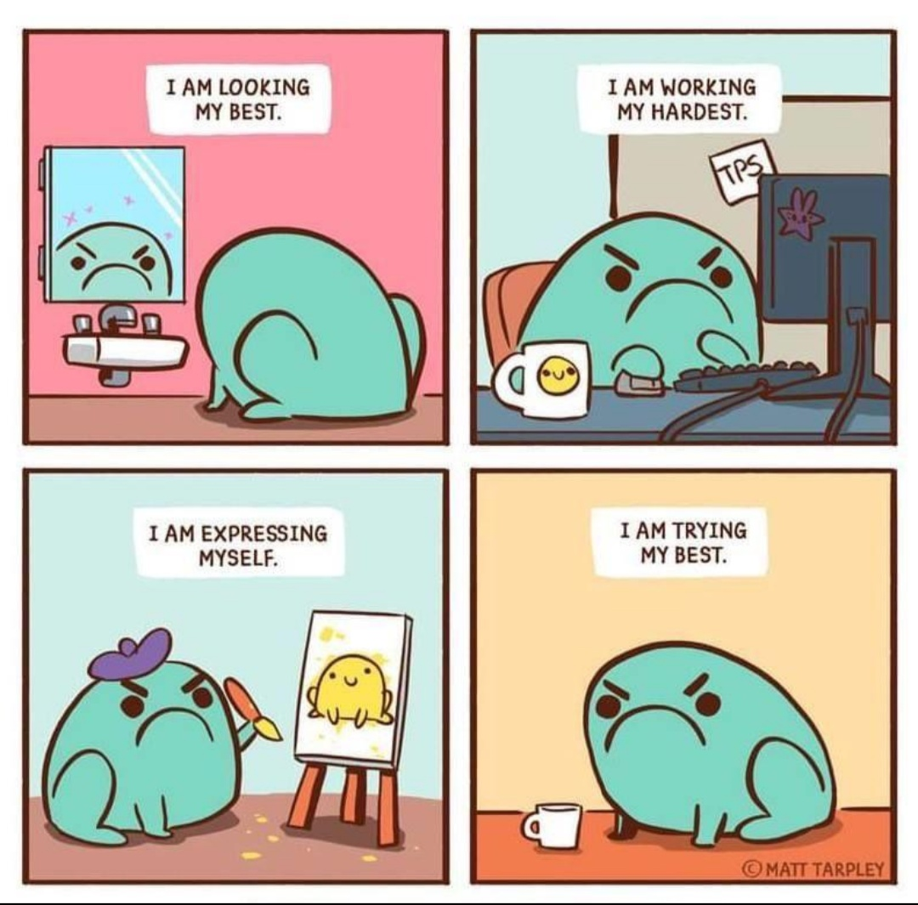
COMMUNITY GUIDELINES
Please take care of yourselves.
Your full participation is appreciated.
There are no bad ideas and there are no “silly” questions.
Teamwork makes the dream work!

Slide 7
01
02
03
INTRO TO USER RESEARCH
UXR OFFICE HOURS
INTRO TO USER RESEARCH 102
USER EXPERIENCE RESEARCH COMPONENTS
04
05
06
INTRO TO USABILITY TESTING
USABILITY TESTING OFFICE HOURS
USABILITY TESTING, PT. 2

Slide 8
01
02
03
INTRO TO USER RESEARCH
UXR OFFICE HOURS
INTRO TO USER RESEARCH 102
USER EXPERIENCE RESEARCH COMPONENTS
04
05
06
INTRO TO USABILITY TESTING
USABILITY TESTING OFFICE HOURS
USABILITY TESTING, PT. 2

Slide 9
LEARNING OBJECTIVES
Learning Objectives
Identifying Problems/Needs
Planning and Executing User Research Interviews
Testing and Refining Assumptions

Slide 10

LEARNING OBJECTIVES
Take Home Assignment
Conduct user interviews with at least 5 people (average 1-4 hours to complete outside of class) to identify their needs and explore the design challenge:
How might we design a solution for college professors to feel confident teaching a hybrid course in Fall 2021?

Slide 11

01
What is user research?

Slide 12
WHAT IS USER RESEARCH?
‘User experience’ (UX) encompasses all aspects of the end-user's interaction with the company, its services, and its products.
-Don Norman & Jakob Nielsen¹
1.“The Definition of User Experience (UX).” Nielsen Norman Group. <https://www.nngroup.com/articles/definition-user-experience/>

Slide 13
WHAT IS USER RESEARCH?
‘User experience’ (UX) encompasses all aspects of the end-user's interaction with the company, its services, and its products.
-Don Norman & Jakob Nielsen¹
Design research focuses on understanding the behaviors, needs, and motivations of people through observation techniques and other feedback methodologies.
1.“The Definition of User Experience (UX).” Nielsen Norman Group. <https://www.nngroup.com/articles/definition-user-experience/>

Slide 14

- Lorinda Mamo
“Every great design begins with an even better story.”

Slide 15
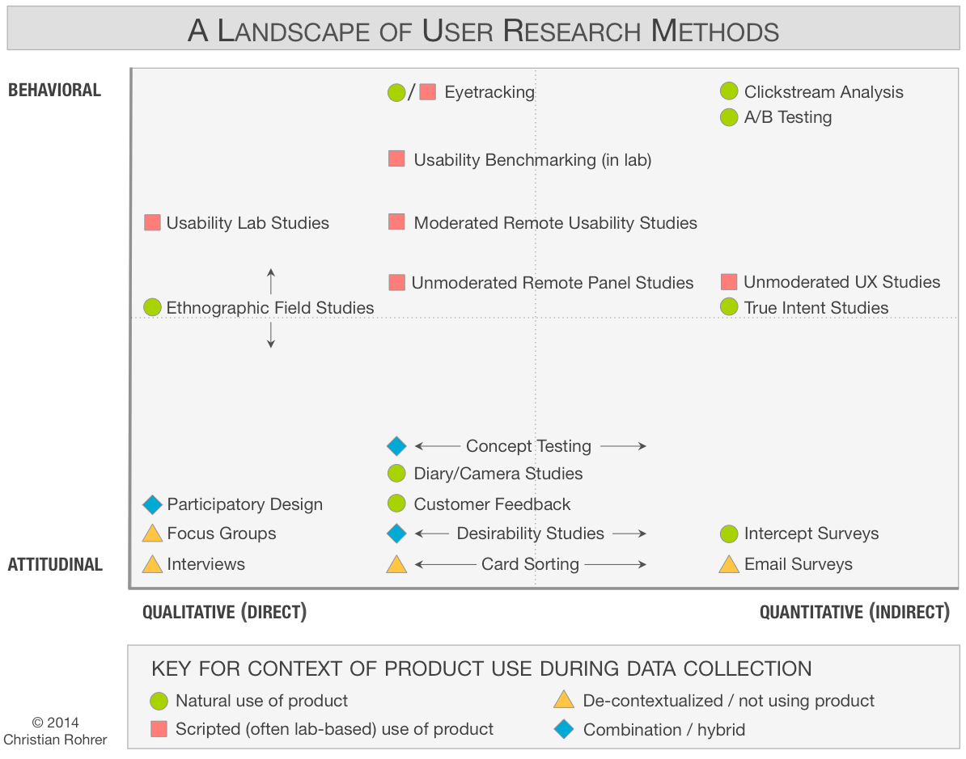
TYPES OF USER RESEARCH METHODS
Source: When to Use Which User-Experience Research Methods. Christian Rohrer. Nielsen Norman Group. October 12, 2014.

Slide 16
TYPES OF USER RESEARCH METHODS
Source: When to Use Which User-Experience Research Methods. Christian Rohrer. Nielsen Norman Group. October 12, 2014.

Slide 17
TYPES OF USER RESEARCH METHODS
Source: When to Use Which User-Experience Research Methods. Christian Rohrer. Nielsen Norman Group. October 12, 2014.

Slide 18
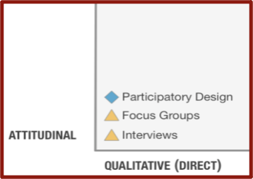
TYPES OF USER RESEARCH METHODS
Source: When to Use Which User-Experience Research Methods. Christian Rohrer. Nielsen Norman Group. October 12, 2014.

Slide 19

Behavioral Methods
TYPES OF USER RESEARCH METHODS
Behavioral research methods focus the actions a person might take.
“How did the bird cross the road?”

Slide 20

Behavioral Methods
Attitudinal Methods
TYPES OF USER RESEARCH METHODS
Behavioral research methods focus the actions a person might take.
Attitudinal research methods focus on understanding the people’s preconceived thoughts, feelings, and motivations toward an experience.
“How did the bird cross the road?”
“Why did the bird cross the road?”

Slide 21
Quiz Time!
Name That Method

Slide 22

NAME THAT METHOD
You want to understand how college students feel about a new university-sponsored cell phone plan. What type of research method would you use?

Slide 23
NAME THAT METHOD
You want to understand how college students feel about a new university-sponsored cell phone plan. What type of research method would you use?
ATTITUDINAL

Slide 24

NAME THAT METHOD
You now want to understand how college students use the new university-sponsored cell phone plan. What type of research method would you use?

Slide 25
NAME THAT METHOD
You now want to understand how college students use the new university-sponsored cell phone plan. What type of research method would you use?
BEHAVIORAL

Slide 26

Qualitative Methods
TYPES OF USER RESEARCH METHODS
Qualitative research methods generate data about behaviors or attitudes by observing people directly.

Slide 27

Qualitative Methods
Quantitative Methods
TYPES OF USER RESEARCH METHODS
Qualitative research methods generate data about behaviors or attitudes by observing people directly.
Quantitative research methods gather data indirectly, through a measurement or an instrument, such as a survey.

Slide 28
Quiz Time!
Name That Method

Slide 29
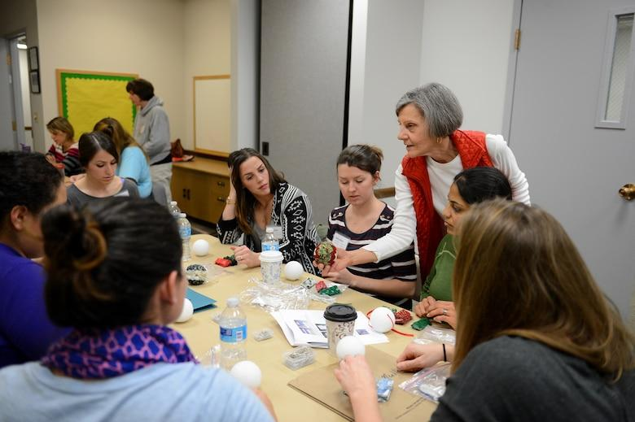
NAME THAT METHOD
Your product team just finished a large market research survey to identify your initial customer base. Your product manager now wants to understand why users are using the product. Which method would you use?

Slide 30
NAME THAT METHOD
IT DEPENDS!
But some of the most common methods you can use are qualitative methods (e.g. user interviews).

Slide 31
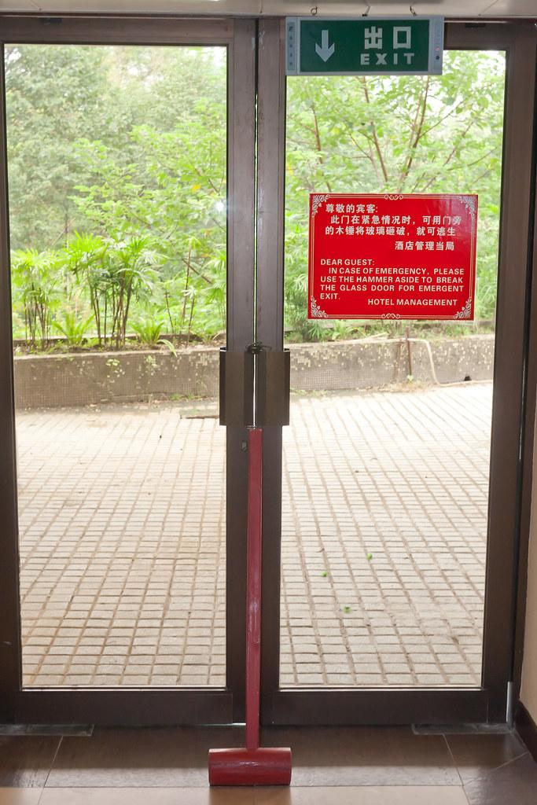
02
Why is user research important?

Slide 32
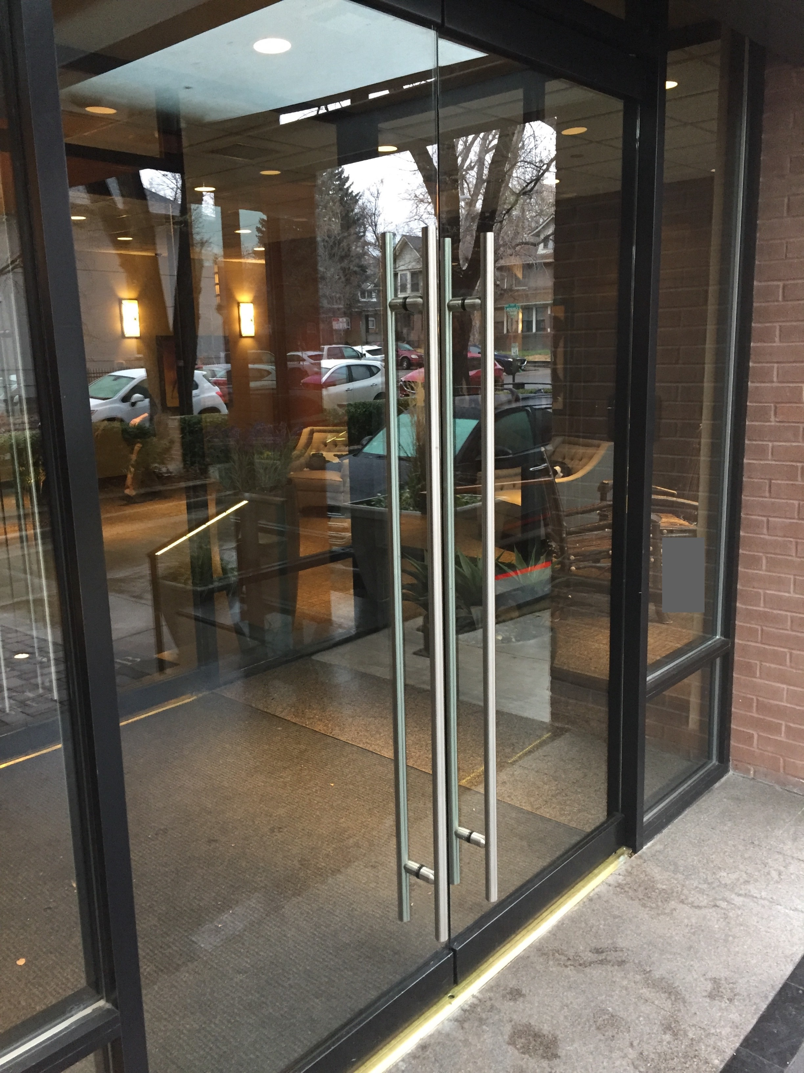
WHY IS USER RESEARCH IMPORTANT?
The Door
How might we open this door?

Slide 33
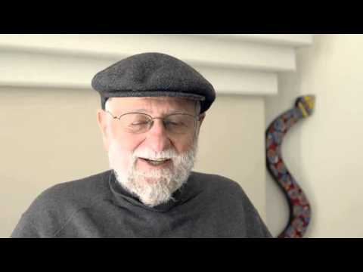
WHY IS USER RESEARCH IMPORTANT?
The Door
How might we open this door?

Slide 34
WHY IS USER RESEARCH IMPORTANT?
People (and teams) do user research to:
Help remove assumptions made about users
Understand user behaviors and how they make decisions
Provide insight into how people think about your company or product
Give you and your team information for better decision-making about your product or service
Improve critical moments in service delivery
Help identify new business opportunities

Slide 35
TYPES OF USER RESEARCH METHODS
The double diamond process illustrates the four phases of exploring a problem widely and deeply (divergence) and then taking focused action (convergence).
Problem
Problem/Definition
Solution
Discover
Explore/
Define
Design
Implement
Insight into the problem (Initial project and research planning, and alignment)
Primary establishment of user needs and interpretation of findings
Research-backed assets used to inform project strategy
Finalized outcome of strategy, evaluation, and feedback

Slide 36
DOUBLE DIAMOND PROCESS
The double diamond process illustrates the four phases of exploring a problem widely and deeply (divergence) and then taking focused action (convergence).
DESIGN THE RIGHT THING
DESIGN THINGS RIGHT
Problem
Problem/Definition
Solution
Discover
Explore/
Define
Design
Implement
Insight into the problem (Initial project and research planning, and alignment)
Primary establishment of user needs and interpretation of findings
Research-backed assets used to inform project strategy
Finalized outcome of strategy, evaluation, and feedback

Slide 37
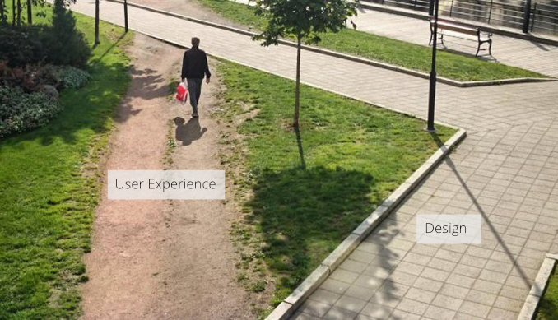
WHY IS USER RESEARCH IMPORTANT?

Slide 38
Break Time!
5 minutes

Slide 39

03
How do you do user research?

Slide 40
HOW DO YOU DO USER RESEARCH?
Conducting user research:
Identify your stakeholders
Identify your business and research goals
Develop your plan
Execute your plan
Synthesize & analyze your findings

Slide 41
HOW DO YOU DO USER RESEARCH?
Conducting user research:
Identify your stakeholders
Identify your business and research goals
Develop your plan
Execute your plan
Synthesize & analyze your findings

Slide 42

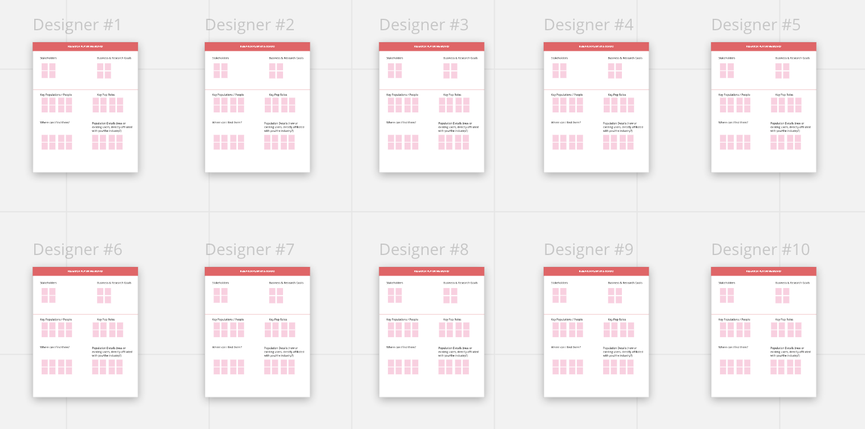
MIRO ORIENTATION
Notes:
https://miro.com/app/board/o9J_l_goegg=/

Slide 43

MIRO ORIENTATION
Add text
Add “Post-Its”

Slide 44
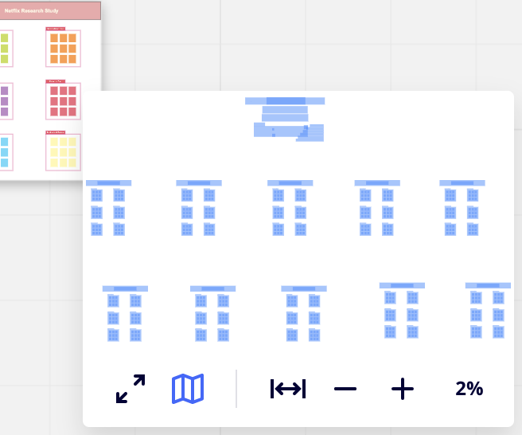
MIRO ORIENTATION
Add text
Add “Post-Its”
Zoom in (+) and out (-) on board

Slide 45
IDENTIFY YOUR STAKEHOLDERS
Questions to consider:
Who are our stakeholders (or people with a vested interest in the goal)?
What are our client’s needs? What goals are they trying to achieve?
What are our needs? How do we maintain those?
How do they interact with our product or service?
What’s the client’s biggest pain point?
What area do we see the most opportunity?

Slide 46
DEVELOP YOUR PLAN
How might we design a solution for college professors to feel confident teaching a hybrid course in Fall 2021?
Who are our stakeholders?

Slide 47
IDENTIFY BUSINESS AND RESEARCH GOALS
Questions to consider:
What products, and/or services are being offered?
What are their current users’ behaviors?
How are they interacting with their products and/or services?
What is the current relationship between the user and the business?

Slide 48
DEVELOP YOUR PLAN
How might we design a solution for college professors to feel confident teaching a hybrid course in Fall 2021?
What are our business and research goals?

Slide 49
DEVELOP YOUR PLAN
Questions to consider:
Who are the key populations you would like to speak to?
What are the roles they play? (Ex. decision-makers, managers, end users)
Who can provide insight into your product and/or service?
Where can you find the right people to speak to?
Are these users that are directly affiliated with your organization?
Are these new or prospective users?

Slide 50
DEVELOP YOUR PLAN
How might we develop a research plan that meets our business and research goals?
How might we design a solution for college professors to feel confident teaching a hybrid course in Fall 2021?

Slide 51
EXECUTE YOUR PLAN
Questions to consider:
What themes are you interested in exploring?
What are the major topics that you will cover?
What questions are important to ask participants?
Roles during the interview:
THE PARTICIPANT
Tells the story

Slide 52
EXECUTE YOUR PLAN
Questions to consider:
What themes are you interested in exploring?
What are the major topics that you will cover?
What questions are important to ask participants?
Roles during the interview:
THE PARTICIPANT
THE RESEARCHER
Tells the story
Guides the story

Slide 53
EXECUTE YOUR PLAN
Questions to consider:
What themes are you interested in exploring?
What are the major topics that you will cover?
What questions are important to ask participants?
Roles during the interview:
THE PARTICIPANT
THE RESEARCHER
THE
NOTETAKER
Tells the story
Guides the story
Captures the story

Slide 54
EXECUTE YOUR PLAN
Questions to consider:
What themes are you interested in exploring?
What are the major topics that you will cover?
What questions are important to ask participants?
Roles during the interview:
THE PARTICIPANT
THE RESEARCHER
THE
NOTETAKER
THE
OBSERVER*
Tells the story
Guides the story
Captures the story
Watches the story
*Optional role

Slide 55
SYNTHESIZE & ANALYZE YOUR FINDINGS
Questions to consider:
What patterns emerge?
What themes emerge?
What insights did you learn?
How does this answer the research question/goal?

Slide 56
SYNTHESIZE & ANALYZE YOUR FINDINGS
Questions to consider:
What patterns emerge?
What themes emerge?
What insights did you learn?
How does this answer the research question/goal?
Example synthesis/analysis methods:
Affinity diagramming/mapping
Thematic analysis
Persona development
Storyboard development
User journey mapping

Slide 57
TIPS FOR CONDUCTING RESEARCH & INTERVIEWING
USERS

Slide 58
+
DO
-
DON’T
TIPS FOR CONDUCTING RESEARCH
Ask open ended questions
“How would you describe this?”
Ask focused and simple questions
“How do you feel about NY pizza?”
Encourage people to explain their thoughts, feelings, and/or behaviors
“Can you tell me more about that?”
Ask “Yes” or “No” questions
“Do you like it?”
Ask loaded and long questions
“Would you say NY pizza is better than Chicago pizza?”
Settle for surface-level answers (*caution: avoid being pushy and work around sensitive topics)
“Okay.”

Slide 59
Questions?

Slide 60
RESOURCES
A Beginner’s Guide to Getting Started in UX Research | Lade Tawak
https://www.notion.so/A-Beginner-s-Guide-to-Getting-Started-in-UX-Research-1e3e0567b4944c938ae8d1a4f0a21c56
User Research Basics | Usability.gov
https://www.usability.gov/what-and-why/user-research.html
Mixed Methods Research: The "Everything You Should Know" Guide | Dscout
https://dscout.com/people-nerds/mixed-methods-research?utm_source=twitter&utm_medium=social&utm_campaign=mixed-methods-research
Awkward Silences: A user research podcast | Erin May, John Henry Forster
https://www.userinterviews.com/podcast

Slide 61
THANK YOU!
Feel free to contact me at:
nechari.riley@gmail.com
Twitter @necharism

